Slide 1
Module 06 – Adding Interactivity
By Darice Corey-Gilbert

Slide 2
Interactive Components
Bootstrap also offers interactive components such as dialogs, dropdown menus, and tooltips, which are designed to enhance user experience when the site is viewed on devices with touchscreens.
When you design websites, it’s also important to keep accessibility in mind.
Some end users will need assistive technologies, such as screen readers to view your site.

Slide 3
Example
For example, think of how you navigate using a mouse versus a touchscreen. Menus and scrolling through a page can be very different experiences depending on whether you are using a desktop compared to a mobile phone or iPad.
On a desktop, you’d most likely use a mouse to scroll or click, whereas on a mobile device or tablet, you’d swipe left, right, up, and down. Therefore, the site needs to have interactive components that allow ease of navigation across devices and browsers.
Another factor you should always consider when developing sites is color contrast. Bootstrap’s default color palette dictates the colors used for buttons, alerts, and validation. You should consult the WCAG color contrast ratio to manually modify the default colors to meet accessibility standards.
At times, you may need to hide content, but it still needs to be accessible to assistive technologies, such as screen readers. For example, any warning pop-ups or information notices, should be adapted.

Slide 4
Web Accessibility Laws and Policies
https://www.w3.org/WAI/Policy/policy/united-states/
https://www.section508.gov/section508_faqs
Section 508, an amendment to the United States Workforce Rehabilitation Act of 1973, is a federal law mandating that all electronic and information technology developed, procured, maintained, or used by the federal government be accessible to people with disabilities.
If you are involved in activities covered under Section 508, you must meet the law's requirements. If the technology is found to be noncompliant, the agency may need to replace it or make it unavailable until it is compliant. This can negatively affect an agency, its mission, and all those who rely on its technological products and services.
The costs and time for remediating the technology to meet Section 508 requirements can be much greater than including Section 508 compliance early in development.

Slide 5

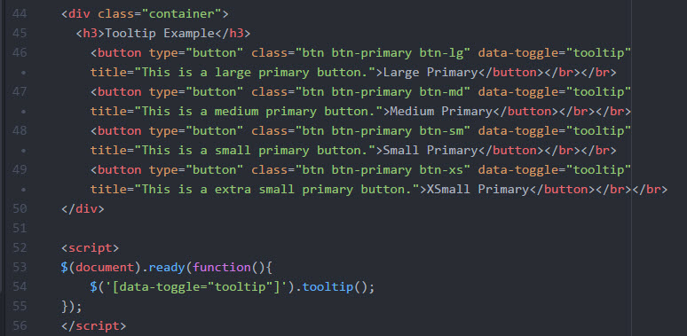
Tooltips
A tooltip is a small pop-up box that appears when the user mouseovers an element. To create a tooltip, you need to add the data-toggle=”tooltip” attribute to an element. The title attribute is used to specify the text that is displayed when the user mouseovers. Tooltips are initialized using jQuery. Note line 7 and 52 in Mod6_ex1.html.

Slide 6
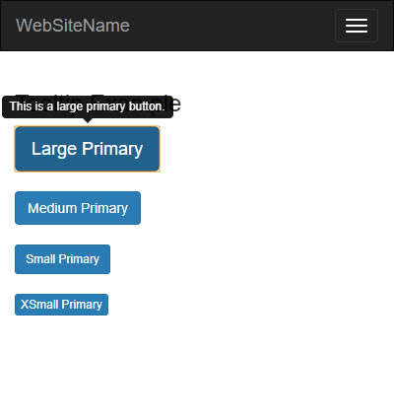
Tooltips
A tooltip is a small pop-up box that appears when the user mouseovers an element. To create a tooltip, you need to add the data-toggle=”tooltip” attribute to an element. The title attribute is used to specify the text that is displayed when the user mouseovers. Tooltips are initialized using jQuery. Note line 7 and 52 in Mod6_ex1.html.

Slide 7
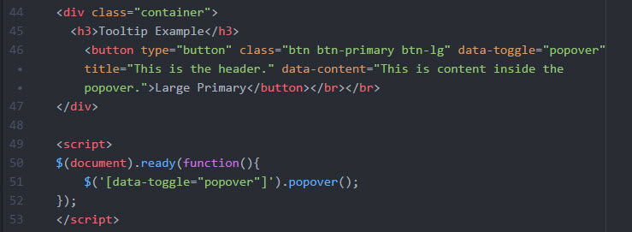
Popover
Popovers are similar to tooltips, but can contain more content. Popovers are implemented by using data attributes:
Data-toggle=”popover” initiates the popover
Title specifies the header text of the popover.
Data-content specifies the text that should be displayed in the body.
Mod6_ex2.html illustrates an example of a popover.

Slide 8
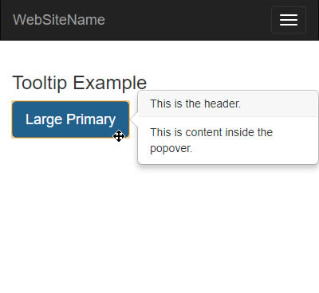
Popover
Popovers are similar to tooltips, but can contain more content. Popovers are implemented by using data attributes:
Data-toggle=”popover” initiates the popover
Title specifies the header text of the popover.
Data-content specifies the text that should be displayed in the body.
Mod6_ex2.html illustrates an example of a popover.

Slide 9
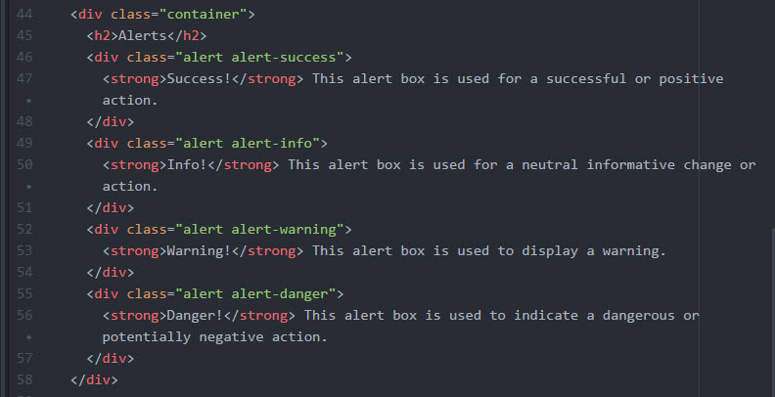
Alerts (1)
Alerts can be added to links or buttons. These can contain options and methods to close alert messages. Mod6_ex3.html illustrates 2 sets of alerts, one is display only, and the other allows the user to click to close it.

Slide 10
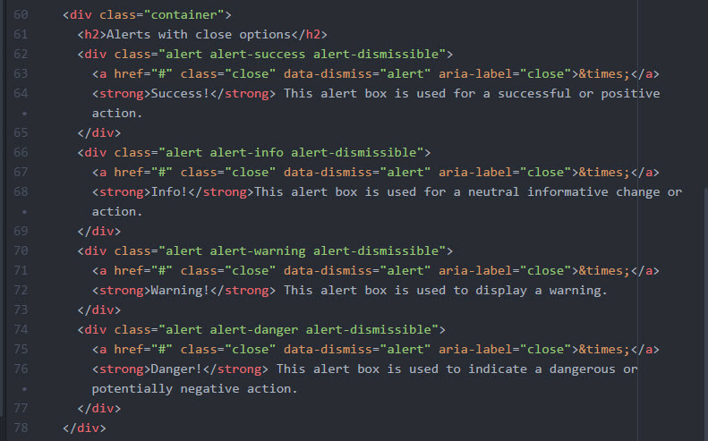
Alerts (2)
Alerts can be added to links or buttons. These can contain options and methods to close alert messages. Mod6_ex3.html illustrates 2 sets of alerts, one is display only, and the other allows the user to click to close it.

Slide 11
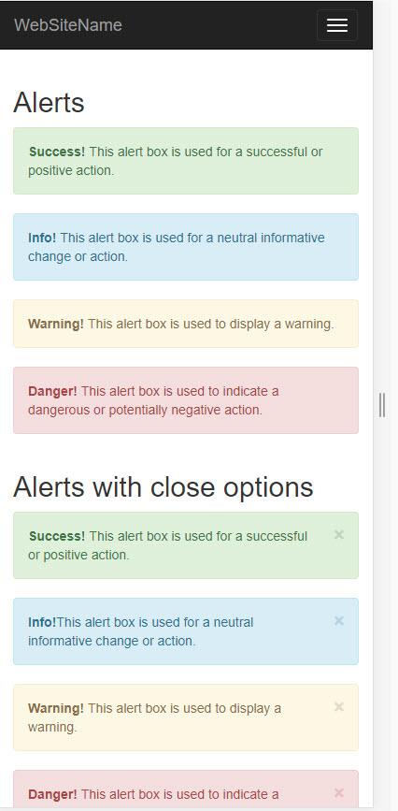
Alerts
Alerts can be added to links or buttons. These can contain options and methods to close alert messages. Mod6_ex3.html illustrates 2 sets of alerts, one is display only, and the other allows the user to click to close it.

Slide 12
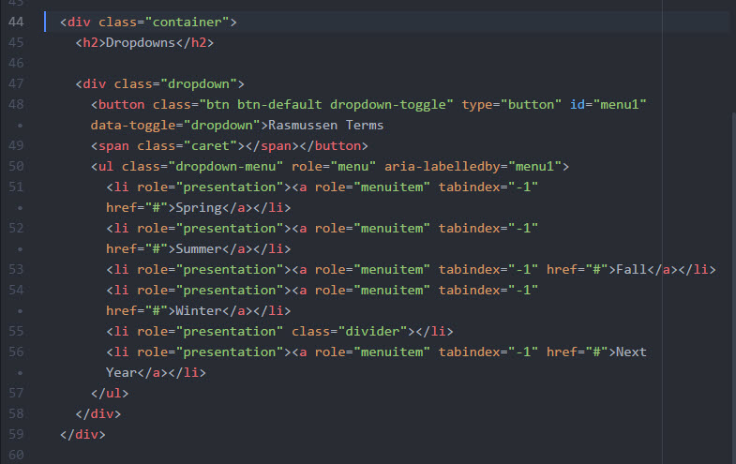
Dropdowns
Dropdowns can be used to allow the user to toggle and select a value from a predefined list. Mod6_ex4.html illustrates an example of a dropdown.

Slide 13
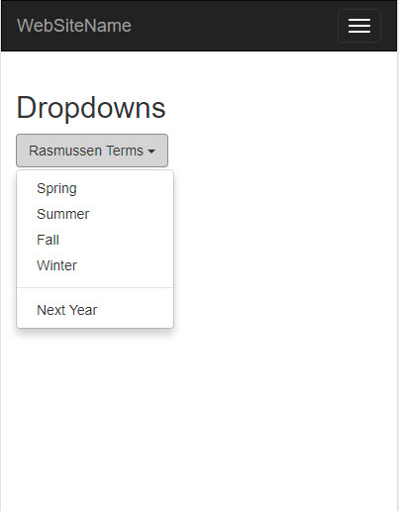
Dropdowns
Dropdowns can be used to allow the user to toggle and select a value from a predefined list. Mod6_ex4.html illustrates an example of a dropdown.

Slide 14
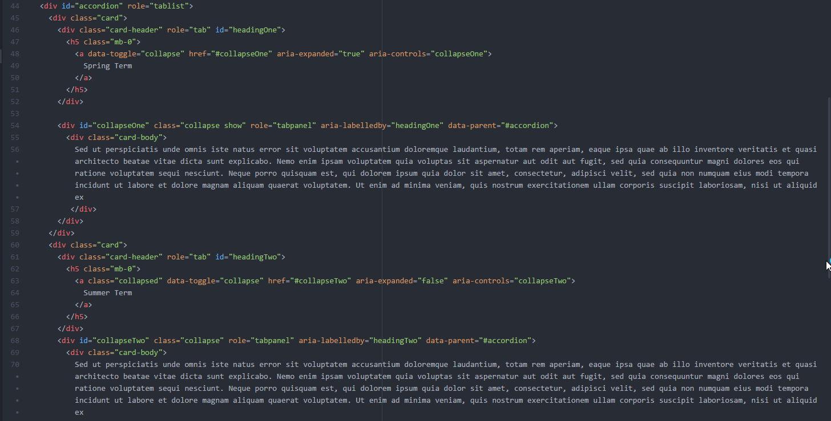
Accordions
Accordions use a component called card that allow you to create collapsible sections of content on a web page.
Mod6_ex5.html illustrates an example.

Slide 15
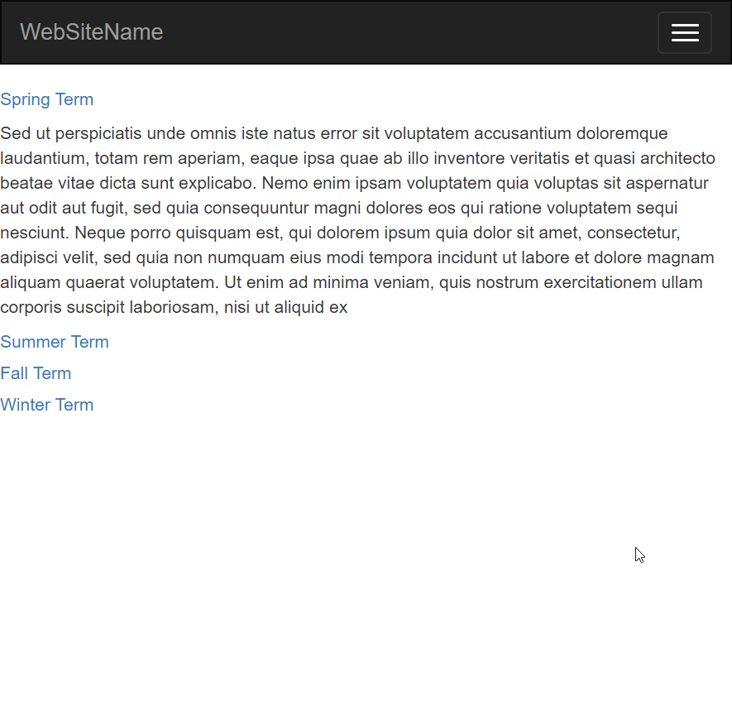
Accordions
Accordions use a component called card that allow you to create collapsible sections of content on a web page. Mod6_ex5.htmlillustrates an example.

Slide 16
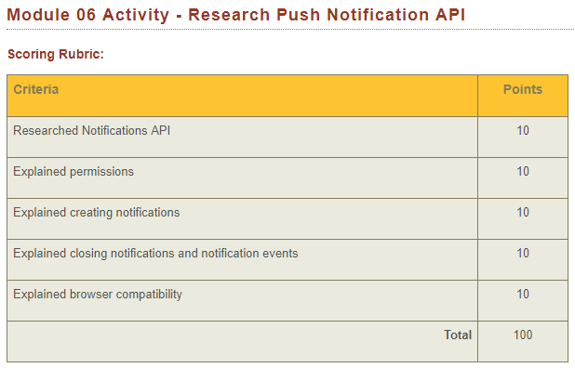
Module 06 Activity – Research Push Notification API
Research the Notifications API in greater detail. In a 1-2 page document, explain the following topics:
Requesting permission
Creating notifications
Closing notifications and notification events
Browser compatibility

Slide 17
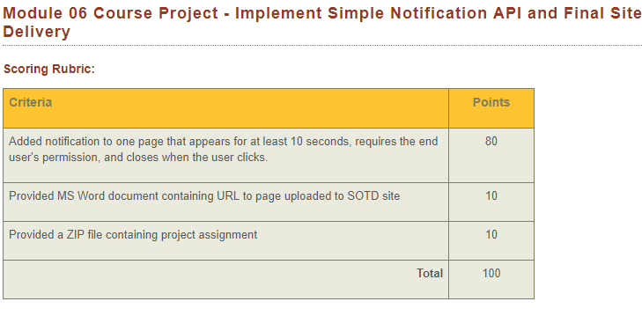
Module 06 Course Project – Implement Simple Notification API and Final Site Delivery
Using the Notifications API, add at least one type of notification to one page of your application.
Your notification must:
Appear for at least 10 seconds.
Require the end user’s permission.
Must close when the user clicks.
Your submission must include the following:
A Microsoft Word Document containing the URL to your revised pages uploaded to your Rasmussen SOTD site. For example: http://sotd.us/[your account name]/CIS4655/projects/module6.html
The Microsoft Word document must also contain screen shots that illustrate 1-2 previews of your notification(s).
A ZIP file containing your Module 06 Course Project assignment
Helpful resource: https://developer.mozilla.org/en-US/docs/Web/API/Notifications_API/Using_the_Notifications_API
An example of Notification API in action: https://davidwalsh.name/demo/notifications-api.php

Slide 18
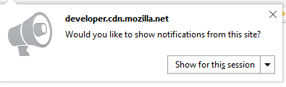
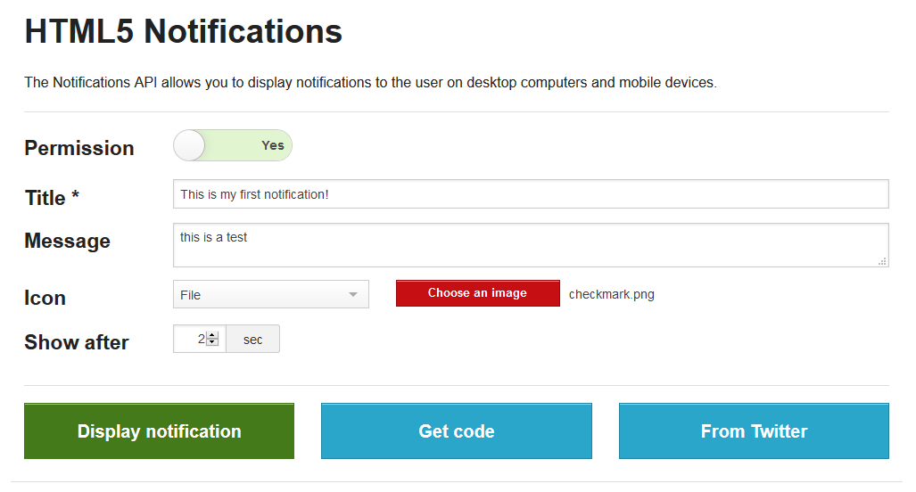
Examples of Notifications APIs
HTML5 Notifier
Sample code: https://1drv.ms/f/s!AvJSMPv8iRDXsnMvawMqbA-5oxMC or https://github.com/dcoreyrasm/AdvancedMobileWebLectures/blob/master/Week5/index.html
Code generator: Mozilla Developer (looks like Mozilla removed this. Still looking for something similar. I’ll share on General Questions Forum once I find an appropriate one.)
Resources: https://developer.mozilla.org/en-US/docs/Web/API/notification

Slide 19
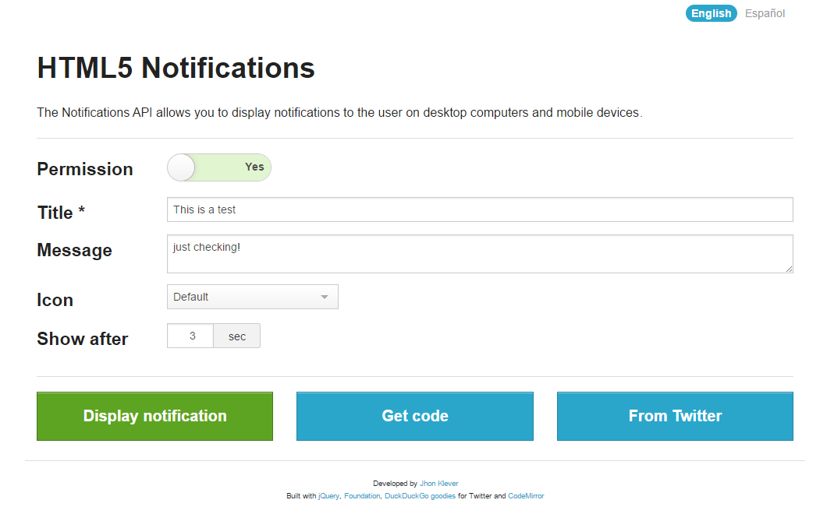
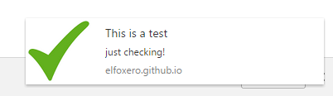
Sample Notification – Code Generator
http://elfoxero.github.io/html5notifications/
Enter a title, message, link to an icon, and determine when the notification should appear.
Click on display notification to test it.

Slide 20
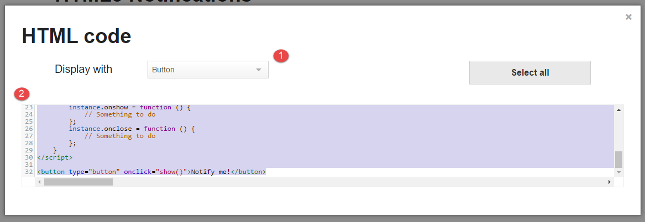
Sample Notification – Code Generator
Click on Get code to copy the code you need to insert to your webpage.
Click to display with a button or link
Highlight and copy the code.

Slide 21
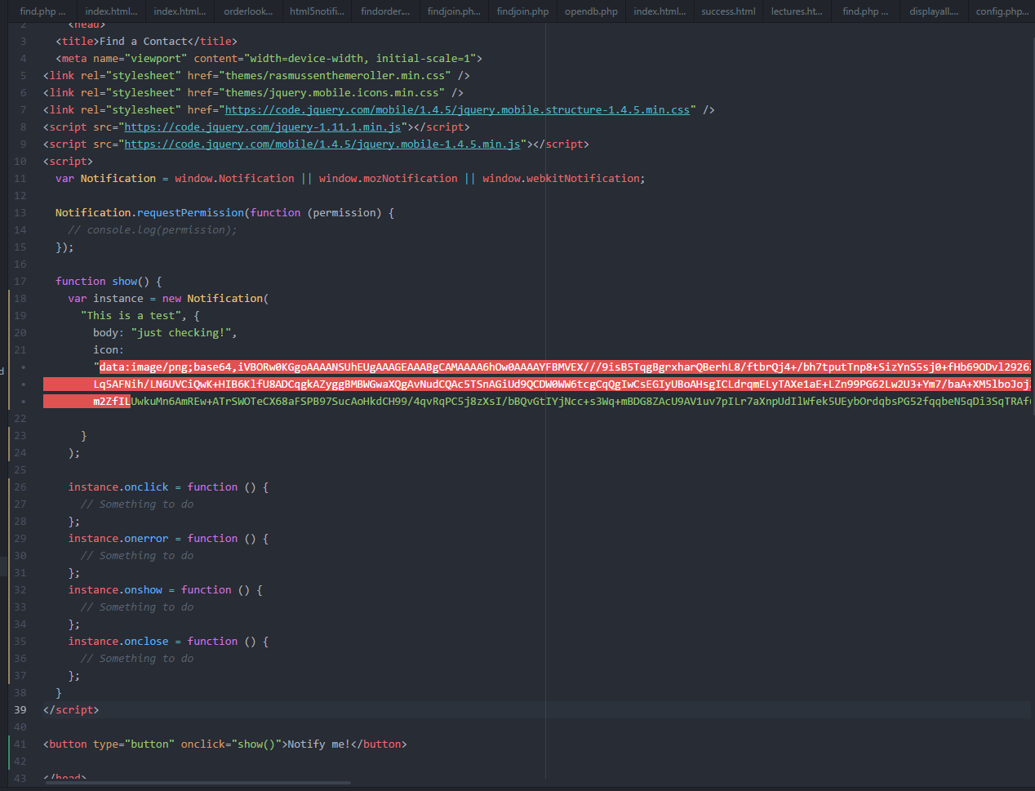
Sample Notification – Code Generator
Paste the code in the <head> section of your HTML or PHP page.
Paste the line containing the button where you’d like it to appear on our page.

Slide 22
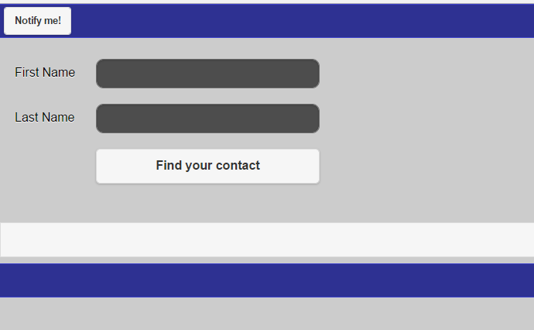
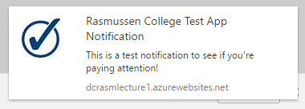
Sample Notification – Code Generator
Commit and sync your git repo and test your page.
Here’s my test: https://dcrasmlecture1.azurewebsites.net/week5/index.html

Slide 23
Notification APIs
Additional Resources: https://developer.mozilla.org/en-US/docs/Web/API/Notifications_API/Using_the_Notifications_API
Sample To-do app with notifications: http://mdn.github.io/to-do-notifications/ (yes it’s really ugly! But shows how the API can be used)
Another sample app: http://mdn.github.io/emogotchi/ (yes it’s really ugly too!)

Slide 24

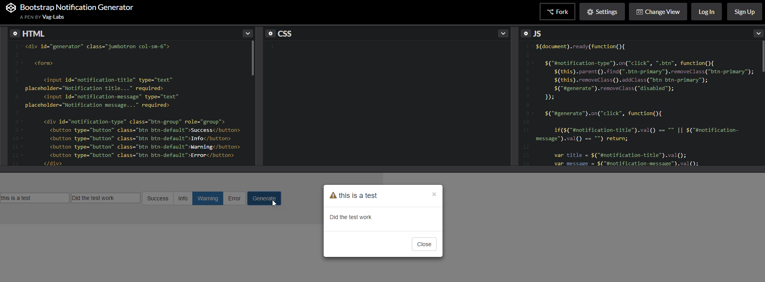



Another example: Bootstrap Notification Generator + code
https://codepen.io/Vagelis90/pen/pJWEGR

Slide 25
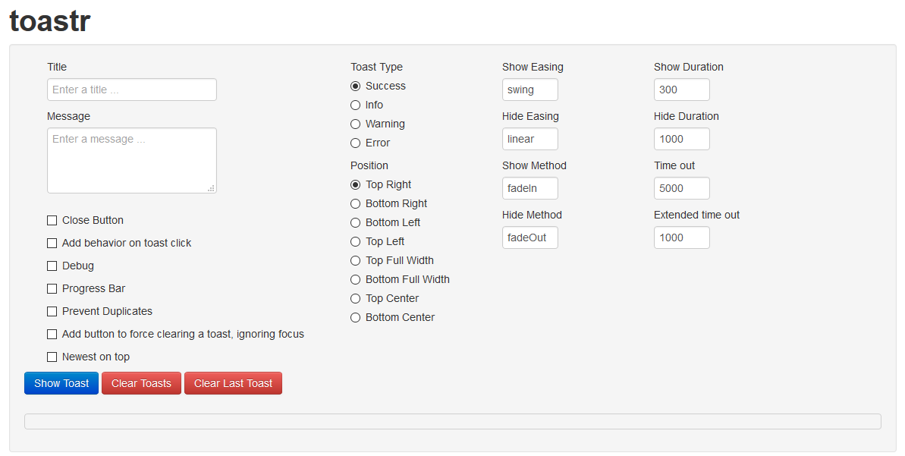
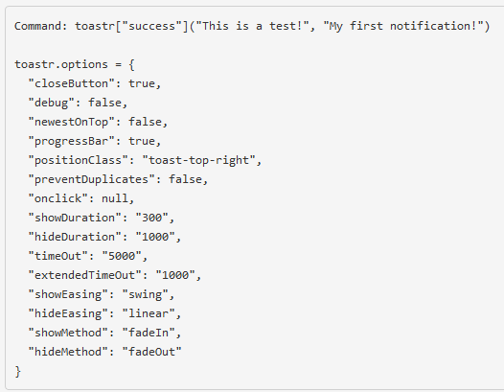

Another Example of Notifications APIs
Toastr
Sample Code: http://1drv.ms/1TOWhzb
You can use the demo site to customize your notification: http://codeseven.github.io/toastr/demo.html

Slide 26
Live Lecture Keyword…
Don’t forget to enter this for the Live Lecture Quiz!

